Slide 1
Model Performance

Slide 2
Test Train Split
Split Randomly data into Test and Train
General rules 80/20, 70/30

Slide 3
Cross-Validation
What if we don’t have enough data to set aside a test dataset?
Cross-Validation:
Each data point is used both as train and test data.
Basic idea:
Fit model on 90% of the data; test on other 10%.
Now do this on a different 90/10 split.
Cycle through all 10 cases.
10 “folds” a common rule of thumb.

Slide 4
Ten Easy Pieces
Divide data into 10 equal pieces P₁…P₁₀.
Fit 10 models, each on 90% of the data.
Each data point is treated as an out-of-sample data point by exactly one of the models.

Slide 5
Ten Easy Pieces
Collect the scores from the red diagonal…
…You have an out-of-sample lift curve based on the entire dataset.
Even though the entire dataset was also used to fit the models.

Slide 6
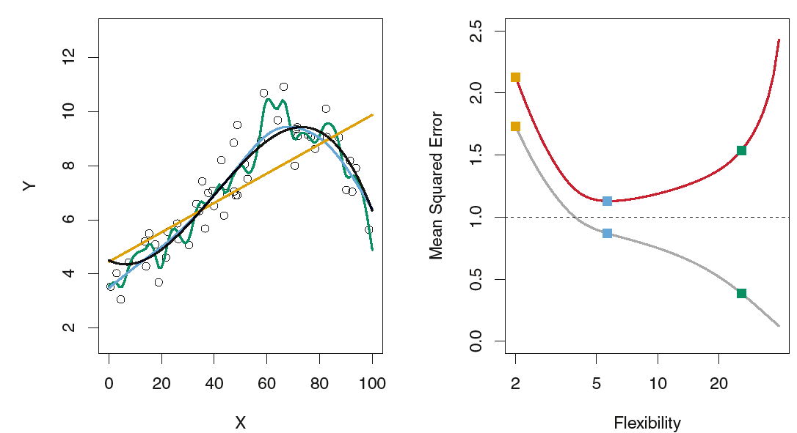
There is no guarantee that the method with the lowest training MSE will also have the lowest test MSE.
Three estimates of Y= f (X)are shown: the linear regression line (orange curve), and two smoothing spline fits (blue and green curves).
Right: Training MSE (grey curve), test MSE (red curve), and minimum possible test MSE over all methods (dashed line).
Squares represent the training and test MSEs for the three fits shown in the left-hand panel.

Slide 7
The Bias-Variance Trade-Off
In order to minimize the expected test error, we need to select a statistical learning method that simultaneously achieves low variance and low bias.
Variance refers to the amount by which f(X) would change if we use different training data set.
Since the training data are used to fit the statistical learning method, different training data sets will result in a different f(X). But ideally the estimate for f(X) should not vary too much between training sets.
However, if a method has high variance then small changes in the training data can result in large changes in f(X).
In general, more flexible statistical methods have higher variance. (neural net, polynomial regression)

Slide 8
Bias refers to the error that is introduced by approximating a real-life problem, which may be extremely complicated, by a much simpler model. (training error)
For example, linear regression assumes that there is a linear relationship between Y and X1,X2, . . . , Xp.
It is unlikely that any real-life problem truly has such a simple linear relationship, and so performing linear regression will undoubtedly result in some bias in the estimate of f(x).
In previous example linear regression(orange line) results in high bias
As a general rule, as we use more flexible methods, the variance will increase and the bias will decrease.
As we increase the flexibility of a class of methods, the bias tends to initially decrease faster than the variance increases.

Slide 9
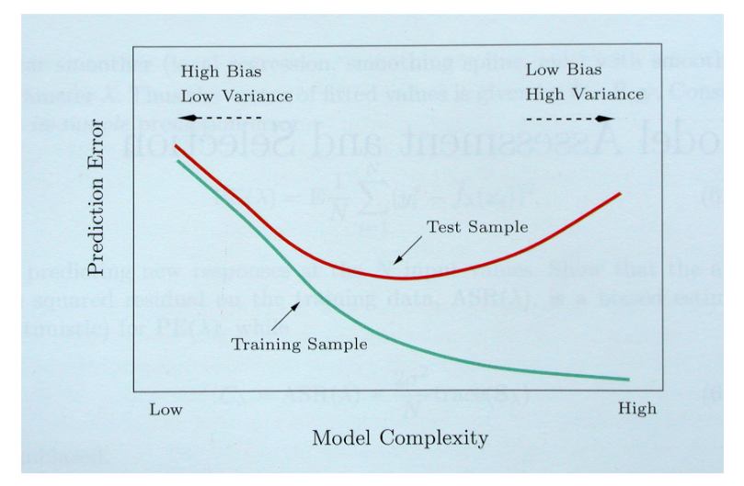

Slide 10
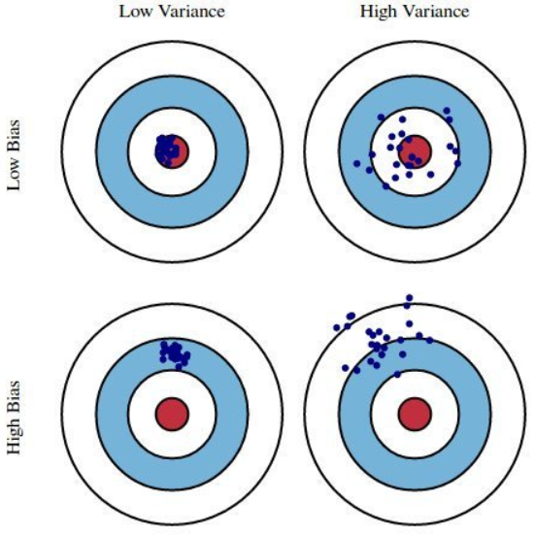
Low Bias, high variance: Overfitting
High bias, low variance: Underfitting

